Slide 1

FRESH DIRECT Background
FreshDirect is a premium online fresh food and grocery retailer with no brick and mortar store.
Serving the NY metro area for over 16 years, Fresh Direct has established itself as the leader and pioneer in the online grocer space. FD delivers premium quality fresh-from-the-farm foods and brand-name groceries directly to customers in the greater NY, NJ, CT, Philadelphia (launched September ‘12) and DC (launched April ’17) metro areas.
Fresh food is directly sourced from a range of organic, sustainable, grass fed, cage free and fair trade farmers and organizations across the United States, with many located within a 300-mile radius of our service area. Our local meats, produce, and dairy come straight from the farmers to FreshDirect's climate-controlled center.
Produce quality ratings from one to five stars, take the guesswork out of shopping, allowing customers to make informed decisions.
Guaranteed freshness dates enable customers to better plan meals, avoid waste, and save money.
Steaks, deli meats and cheeses are cut fresh to order (thickness, quantity) so these items are as fresh as going to a specialty store.
Full line of ‘private’ brand products (JUST brand food and Cloud9 paper) offering ‘clean ingredients’ from sources we trust
Shopping apps for smartphones. Quick-Shop shopping lists that make ordering weekly basics fast, easy and forget-proof.
Low-maintenance meals such as "Sides in a Snap," "4-Minute Meal" entrees, or "Heat & Eat" for busy shoppers on the go.
"Green Delivery," allows shoppers to see when deliveries are being made to their area and opt for a compatible delivery time.
DeliveryPass feature, which enables unlimited deliveries within a 6-month or 1-year period for a flat fee

Slide 2
FRESH DIRECT Background
FD’s corporate offices (COS) division launched in 2005 and currently serves over 6,000 office customers in these areas; with the majority located in Manhattan.
FD COS has established itself as a leader in the mid-market corporate food services industry currently delivering pantry/break room items like: snacks, beverages, produce, milk & yogurt, beer/wine and paper products. Nearly 45% of total FD COS customers have regular scheduled ‘standing orders’ with the service.
FD’s FoodKick brand launched January ‘16 and offer same-day delivery to customers in Manhattan, Brooklyn and parts of Queens.
FoodKick is built on a deep understanding of the food needs of busy, urban dwellers who live on demand, embrace spontaneity and love discovery. Rooted in consumer research, the business was designed to be instantly ready for consumers' immediate food decisions - whether that's dinner tonight, last-minute plans, entertaining friends and family, or fill-ins.
FoodKick curates and rotates new food finds and solutions for the on-demand consumer, including meal hacks, food and alcohol pairings, farm-fresh seasonal produce, pantry staples and home essentials. FoodKick also features a growing selection of new and limited-time offerings from partners such as Cocktail Courier, Indie Fresh, Hungry Root and Mille-feuille. An in-

Slide 3
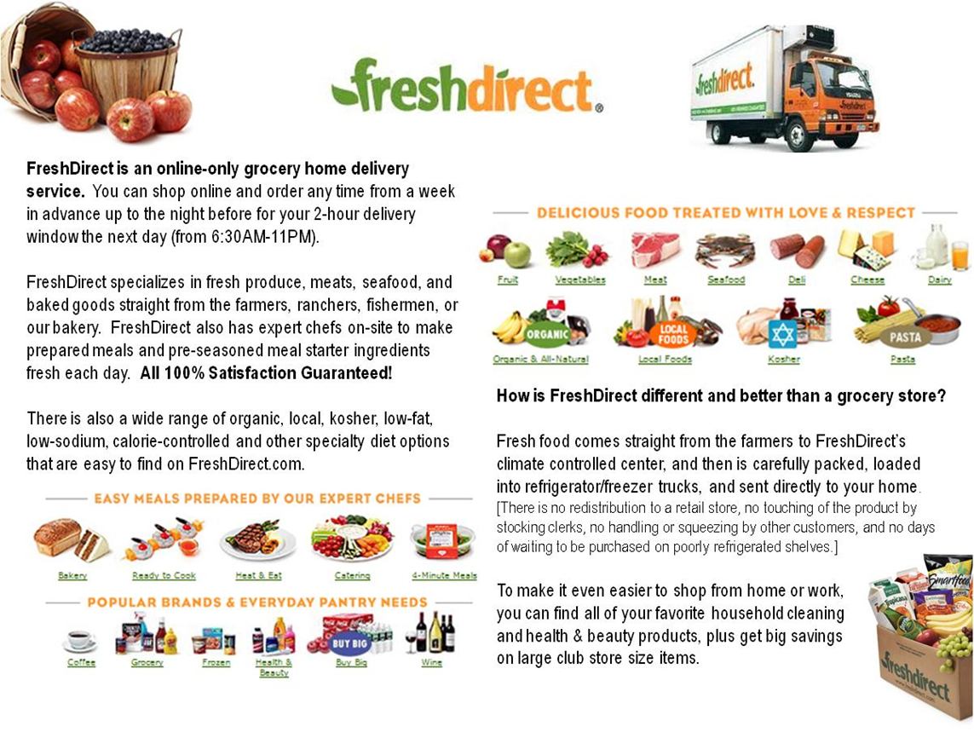

Slide 4
Some helpful information……
The FD customer best customer is:
predominantly female (76%), higher income ($125+)
younger families
slightly older (age 30-55)
The ‘loyal’ customers are defined as those purchasing everyweek or every other week
The ‘loyal’ customers have developed a Habit of shopping with FD
There are some customers that utilize FD for its convenience value or only when there is a promotion (free delivery) but the majority (best customers) are driven by the quality and value of the food.
Over 60% of customers have a DeliveryPass (annual or monthly pass for Free Delivery)
The Loyals primarily get deliveries on Sunday and Monday with smaller fill-in orders during the week

